Slide 1

Lariat Performance Analysis
And how we can do better
Notes:
Open with everyone wants to make more money.

Slide 2
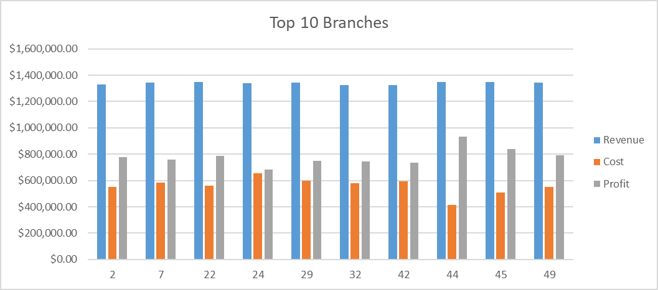
Current Performance
Notes:
Give the base figures on the Company

Slide 3
Factors not Considered
Neither Age nor Gender factored into rental or accidents more than 2%
Airports did not affect revenue more than 2%
Except for the Top 8 branches, all others are within 10% of the others
Company wide roll out should see the same proportional effects to each Branch
Notes:
Why ese weren’t factored into the projection

Slide 4
Working the Strategies
Increase Revenue
Notes:
Explain the levels of strategies

Slide 5
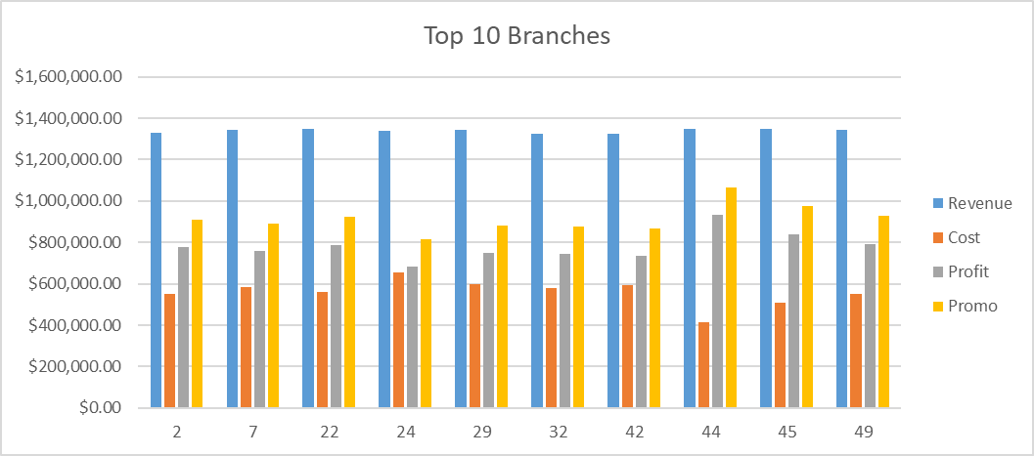
Working the Strategies
Increase Revenue
Promotional offers
Notes:
(Decrease rates to increase number and length of rentals)

Slide 6
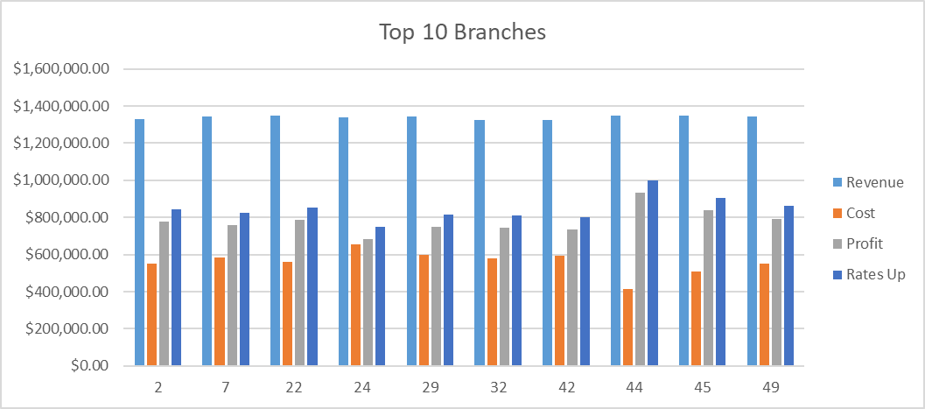
Working the Strategies
Increase Revenue
Promotional offers
Increasing Rental Rates
Notes:
(Inflation level increase of rates across the company)

Slide 7
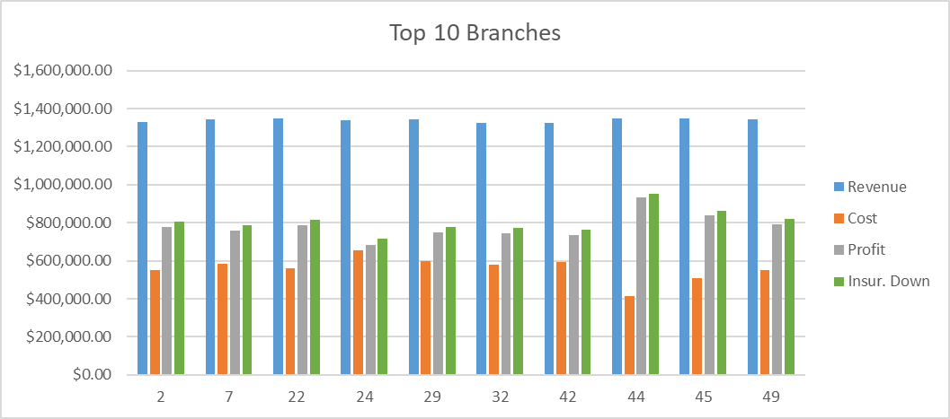
Working the Strategies
Increase Revenue
Promotional offers
Increasing Rental Rates
Decrease Costs
Lower Insurance costs
Notes:
(Shop Insurance companies every year for cheapest rates)

Slide 8
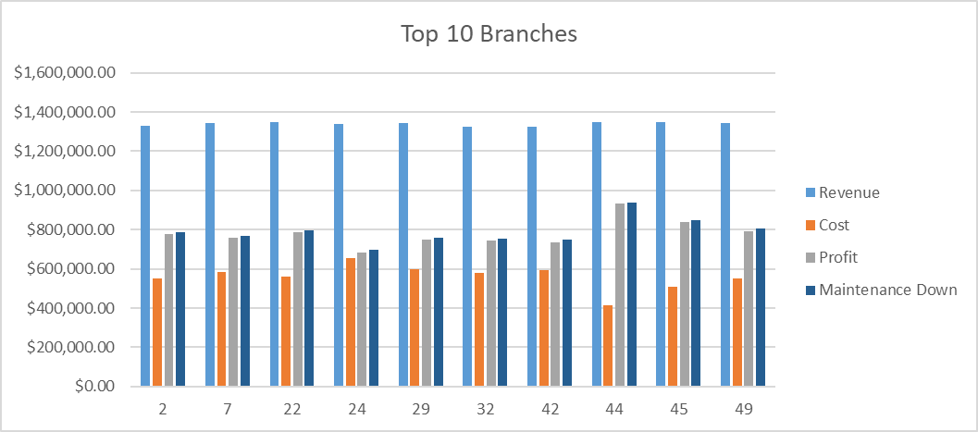
Working the Strategies
Increase Revenue
Promotional offers
Increasing Rental Rates
Decrease Costs
Lower Insurance costs
Lower Maintenance Costs
Notes:
Shop national fleet maintenance vendors to best rates

Slide 9
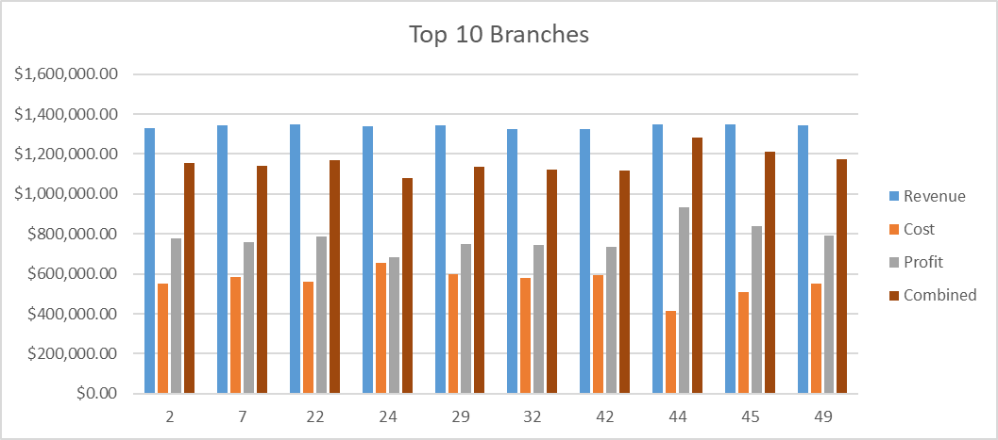
Combined Strategy
Notes:
Explain the combined method

Slide 10
Questions: ???
Notes:
Be Prepared:

Slide 11

Conclusion
Time to move Forward!
Notes:
Quick sum up of why Combined is the best.

